Slide 1
Masters Psychology
Externship/Internship Program
Comprehensive Clinical Child Track
2026
Erica Lee, Psy.D. and Eli Getzoff, Ph.D.
Program Coordinators

Slide 2
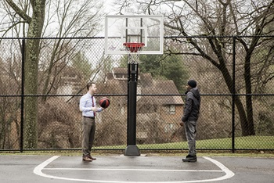

In a Nutshell…
Our program consists of a combination of outpatient initial consultations and outpatient therapy within a pediatric population!

Slide 3

Our Population
Children from ages 4 years old to 18 years old
Diverse economic, ethnic, cultural, and environmental backgrounds
Presenting problems include…a little bit of everything!
  Neurodevelopmental disorders (i.e. autism, ADHD)
  Externalizing and internalizing issues (i.e. ODD, depression, anxiety)
  Children exposed to adverse experiences
  Academic problems
  Working with the family system
We do not typically see: eating disorders, substance abuse, and actively suicidal cases

Slide 4
Clinical Work
Therapy
(As of right now) opportunities for in person and telehealth
You will be assigned a supervisor based on clinical interests
  Most of our supervisors follow a Cognitive Behavioral approach, but each have their own area of expertise and experience and often integrate from other theoretical approaches
Goal is to have a wide range of exposure to a variety of mental health issues related to children, with opportunities to gain experience in a specialized area of interest
Will learn a variety of interventions individualized for the patient
Patients typically meet with their clinician weekly or bi-weekly
Externs can expect that their 3:00pm and 4:00pm time slots to be booked, with a minimum of 3-4 therapy patients during ramp up period and increasing during internship period

Slide 5
Supervision and Didactics
Heading Goes Here
Each extern will be assigned a primary therapy supervisor and guaranteed as least one hour of individual supervision per week, with this increasing as your caseload increases
The Pediatric Psychology Didactic (Friday 2:00pm)
  Didactics are held weekly. Topics include issues in pediatric psychology, working in a hospital, professional and ethical issues, diversity, research, and other special topics.

Slide 6

Additional Didactics
Due to the nature of our department, all trainees are welcome to other didactics and seminars within other specialty areas (i.e. neuropsychology, trauma, autism)
Assessment Seminar (Friday 1:00pm)
  Each week, trainees present the relevant history of an assessment case to the group, as well as the results from their testing.

Slide 7
Logistics
Year typically starts from January to December
Parking on campus is free.
Shared office with computers, sign out rooms for clinic work
Access to cafeteria & refrigerator if you bring your own lunch/food
Hours are 8:30am-5:00pm
  Externs may schedule clients outside of these required hours (e.g., 8:00am, 5:00pm or 6:00pm) as long as there is a licensed psychologist present.
Vacation: 6 major holidays the hospital is closed, and you have off if it falls on your day.
  Externs are also allotted an additional 5 vacation days to use at their discretion.
  Additional days may be requested and used for sick days, conferences, etc. with supervisor permission.

Slide 8
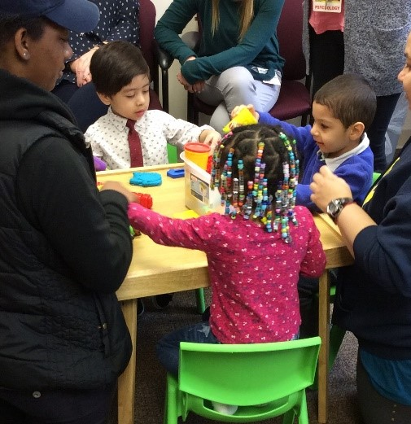
Looking forward to meeting you!
For more information or questions, feel free to contact us at:
Erica Lee, PsyD
ELee@mwph.org
Elizabeth Getzoff, PhD
Egetzoff@mwph.org
https://www.mwph.org/health-services/behavioral-health/pediatric-psychology

