Slide 1
Doctoral Psychology Externship
Trauma and Healing Track
2026- 2027
Lindsay Gavin, Ph.D.
Program Coordinator

Slide 2
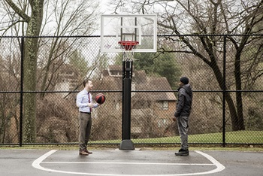

In a Nutshell…
Our program consists of a combination of outpatient therapy, consultation, testing, and community outreach within a pediatric population who have been impacted by trauma.

Slide 3
Our Population
Children from ages infants/toddlers to 18 years old
Diverse economic, ethnic, religious, cultural, and geographic backgrounds
Presenting issues include a primary focus on exposure to trauma and trauma symptoms, in addition to:
  Neurodevelopmental disorders (i.e. autism, ADHD)
  Externalizing and internalizing issues (i.e. depression, anxiety, self-harm, behavioral concerns)
  Academic problems
  Working with the family system
We do not typically see: eating disorders, substance abuse, and actively suicidal cases – those cases will be referred to a higher level of care

Slide 4
Clinical Work: Therapy
(As of right now) opportunities for in person and telehealth
All supervisors are certified in Trauma-Focused Cognitive Behavioral Therapy (TF-CBT) in addition to being trained in other trauma intervention modalities (e.g. EMDR, ARC, ABC, CPP) which you will get exposure to your training year
Every student will get formally trained in a 2-3 full day training for TF-CBT via an outside training agency at the start of the externship year; this will be funded and paid for by our program
  This foundational training will help you seek certification in TF-CBT in the future, if you are interested
Patients typically meet with their clinician weekly
Externs can expect that their 3:00pm and 4:00pm time slots to be booked weekly and to hold a minimum of 5-6 weekly patients

Slide 5

Clinical Work: Assessment
Externs will test at least 2 times per month
  Changes to the schedule can be discussed during the interview
Primary reasons for referral include:
  Social, emotional and behavioral functioning
  Adaptive functioning/Intellectual functioning/Autism
  Attention/concentration/Hyperactivity concerns
  Academic skills
  Of course, trauma history in present in all cases
All batteries include cognitive testing, academic testing (if needed), executive functioning testing, social-emotional/behavior measures (parent, self, and teacher reports) and trauma measures; autism testing is often included based on referral questions
Students are involved in the entire assessment process from administration, scoring/interpretation/report writing, and giving feedback to families
Students will be given feedback via live supervision through one-way mirrors
Students will have the opportunity to learn how to test via iPad administration

Slide 6
Supervision and Didactics
Heading Goes Here
Each extern will be assigned a primary therapy and testing supervisor (may be the same person or 2 different people) and guaranteed as least 1 hour of individual supervision per week
Group Supervision, Testing Seminar and Didactics
  Each week, trauma externs will participate in a weekly group meeting together with the other trauma externs and all of the trauma faculty. Meetings will either focus on consultation of trauma therapy cases (group supervision), presentation of trauma evaluation cases (testing seminar), or didactics in topics specific to trauma (e.g., Dissociation, Medical Trauma, Working with Foster Care Youth, etc.)

Slide 7

Additional Didactics
Due to the nature of our department, all trainees are welcome to other didactics and seminars within other specialty areas (i.e. neuropsychology, outpatient, autism)

Slide 8
Logistics
Year typically starts from beginning of July to end of June
Orientation is usually last Friday in June
There will be one shared day for all trauma externs and your second day can be based on your schedule
Parking on campus is free
Shared extern office with computers, sign out rooms for clinic work
Access to cafeteria & refrigerator if you bring your own lunch/food
Hours are 8:30am-5:00pm
  Externs may schedule clients outside of these required hours (e.g., 8:00am, 5:00pm or 6:00pm) as long as there is a licensed psychologist present
Vacation: 6 major holidays that hospital is closed
  Externs are given the week between Christmas and New Year’s Eve off. Externs are also allotted an additional 5 vacation days to use at their discretion
  Additional days taken must be made up on another day

Slide 9
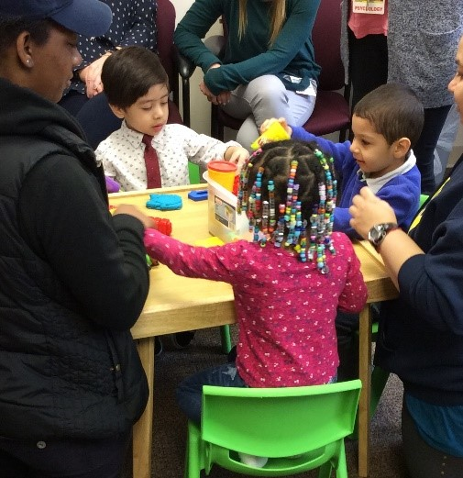
Looking forward to meeting you!
For more information or questions, feel free to contact me at:
Lindsay Gavin, Ph.D.
Licensed Psychologist
Coordinator of the Trauma and Healing Program
Lindsay.gavin@mwph.org
410-578-5252
Please cc:
Erica Lee, PsyD
ELee@mwph.org
https://www.mwph.org/health-services/behavioral-health/trauma-and-healing-program

