Slide 1
Doctoral Psychology Externship
Integrated Diabetes Clinic & Integrated Primary Care
2026
Bradley Schwimmer, Psy.D.
Erica Lee, Psy.D. and Eli Getzoff, Ph.D.
Program Coordinators

Slide 2
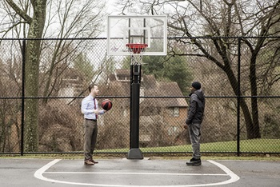
In a Nutshell…
This externship track consists of a combination of outpatient therapy and testing within a pediatric population, as well as consultation within a Diabetes and Primary Care Clinic

Slide 3

Our Population
Children from ages 4 years old to 18 years old
Diverse economic, ethnic, cultural, and environmental backgrounds
Presenting problems include…a little bit of everything!
  Neurodevelopmental disorders (i.e. autism, ADHD)
  Externalizing and internalizing issues (i.e. ODD, depression, anxiety)
  Children exposed to adverse experiences
  Academic problems
  Working with the family system
We do not typically see: eating disorders, substance abuse, and actively suicidal cases

Slide 4
Integrated Diabetes Clinic & Integrated Primary Care
The extern(s) will be part of an integrated medical team in two distinct clinics: Diabetes & Primary Care
The extern is encouraged take on patients with chronic and acute medical conditions for individual therapy.
DIABETES
The extern(s) will work collaboratively
with physicians, medical residents and fellows, dietitians, social workers, and nurses to improve/treat medication compliance, medical phobias, and issues related to adjustment to chronic illness.
In addition to treating patients in clinic,
the extern will take on therapy patients with issues with diabetes compliance.
PRIMARY CARE
The extern(s) work with physicians, nurses, medical residents, psychiatry, & social work to provide care for children with genetic conditions, orthopedic conditions, developmental delays, behavioral health problems, feeding issues, and/or other chronic medical conditions.
In addition, the clinic treats infants born with complex medical conditions with the emphasis on achievement of development.

Slide 5
Clinical Work
Therapy
(As of right now) opportunities for in person and telehealth
You will be assigned a supervisor based on clinical interests
  Most of our supervisors follow a Cognitive Behavioral approach, but each have their own area of expertise and experience and often integrate from other theoretical approaches
Goal is to have a wide range of exposure to a variety of mental health issues related to children, with opportunities to gain experience in a specialized area of interest
Will learn a variety of interventions individualized for the patient
Patients typically meet with their clinician weekly or bi-weekly
Externs can expect that their 3:00pm and 4:00pm time slots to be booked, with a minimum of 4 therapy patients

Slide 6

Clinical Work
Assessment
Externs will test approximately 2 times per month on Fridays
Primary reasons for referral include:
  Academic skills
  Adaptive functioning/Intellectual functioning
  Attention/concentration/Hyperactivity concerns
  Working memory capacities/fine motor skills
  Social, emotional and behavioral functioning
All batteries include cognitive testing, academic testing (if needed), and social-emotional/behavior measures (parent, self, and teacher reports)
Students are involved in the entire assessment process from administration, scoring/interpretation/report writing, and giving feedback to families
Students will be given feedback via live supervision through one-way mirrors and bug-in-the-ear approach
Students will have the opportunity to learn how to test via IPad

Slide 7
Supervision and Didactics
Heading Goes Here
Each extern will be assigned a primary supervisor and guaranteed as least one hour of individual supervision per week
The Pediatric Psychology Didactic (Friday 2:00pm)- Encouraged
  Didactics are held weekly. Topics include issues in pediatric psychology, working in a hospital, professional and ethical issues, diversity, research, and other special topics.

Slide 8

Additional Didactics
Due to the nature of our department, all trainees are welcome to other didactics and seminars within other specialty areas (i.e. neuropsychology, trauma, autism)

Slide 9
Externship Program Schedule, Benefits, and Policies
Year typically starts from July to end of June
Orientation is usually last Friday in June
For Comprehensive Clinical Child Track Friday is a mandatory day, your second day can be based on your schedule
Parking on campus is free.
Shared office with computers, sign out rooms for clinic work
Access to cafeteria & refrigerator if you bring your own lunch/food
Hours are 8:30am-5:00pm
  Externs may schedule clients outside of these required hours (e.g., 8:00am, 5:00pm or 6:00pm) as long as there is a licensed psychologist present.
Vacation: 6 major holidays that hospital is closed.
  Externs are given the week between Christmas and New Year’s Eve off. Externs are also allotted an additional 5 vacation days to use at their discretion.
  Additional days taken must be made up on another day.

Slide 10
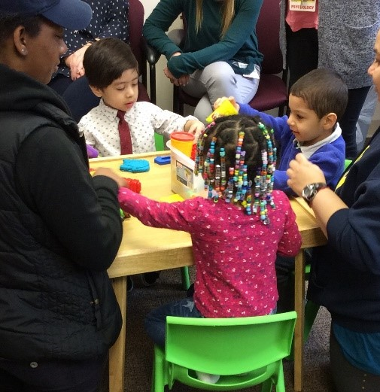
Looking forward to meeting you!
For more information or questions, feel free to contact us at:
Bradley Schwimmer, PsyD
BSchwimmer@MWPH.ORG
Erica Lee, PsyD
ELee@mwph.org
Elizabeth Getzoff, PhD
Egetzoff@mwph.org
https://www.mwph.org/health-services/behavioral-health/pediatric-psychology

